Slide 1
EMPIRICAL MODELING WITH MULTIVARIABLE POLYNOMIALS
AND WHY NEURAL NETWORKS SHOULD MAKE YOU NERVOUS
David A. Vaccari
email: dvaccari@stevens-tech.edu
webpage: http://attila.stevens-tech.edu/~dvaccari/
Notes:
A new class of models for correlation and forecasting
Compares favorably with ANNs
Reduces overfitting
Produces a simple explicit model equation

Slide 2
The Problem of Multivariable Correlation
Independent Variables
Model
Dependent Variable
Notes:
Few tools are available to model multivariable input-output relationships.
Example relationships:
Stock index vs. CPI, Int rates, other economic indicators
Credit rating
Load forecasting
Plant production vs. nutrient, moisture, temp.
WWTP performance vs. flow, composition
Linear methods:
Multilinear regression
Principle component analysis
Factor Analysis
ARMA modeling
Artificial Neural Networks
Response Surface Models

Slide 3
Biomass Production Example:
Plant Growth Model
Carbon Dioxide
Photosynthetic
Efficiency
Temperature
Photoperiod

Slide 4
Food Processing Example:
Double-Screw Extrusion
Feed Rate
Texture
Screw Speed
Temperature

Slide 5
Waste Recovery Example:
Bioregenerative Air Treatment
Ammonia Conc.
N₂O Production
Loading Rate
Temperature

Slide 6
How can you solve the multivariate problem?
Multilinear Regression
Artificial Neural Networks
Multivariate Polynomial Regression
Factor Analysis
Principle Component Analysis
Notes:
These are (other than MPR) the choices that are commonly available and known.

Slide 7
Artificial Neural Networks
Input
Layer
Hidden
Layer
Output
Layer
Notes:
For ANNs:
Fitting process consists of iterative algorithm to select weights which make the model fit the data, usually by minimizing some criterion such as SSE.

Slide 8
A Single ANN Node
Notes:
FEEDFORWARD BACKPROPAGATION ANN
Sum the inputs, then pass through a sigmoid function.

Slide 9
ANN Advantages
Can make very accurate fits to data
Describes complex relationships
Can handle high dimensional problems
“Graceful” degradation
Notes:
Advantages
Accurate fits
Can describe complex relationships
Efficient for high dimensionality
“Graceful” failure - elimination of nodes doesn’t always degrade behavior - because those weights are not significant, or outcome is due to combined effect of many weights - how do you know which ones are?

Slide 10
ANN Disadvantages
Structure must be determined a priori
Overfitting difficult to prevent
Not parsimonious: May have a large number of unnecessary weights
Difficult to analyze
Hidden and unpredictable behavior
Notes:
Disadvantages
Structure must be chosen a priori
Not parsimonious
Weights may not be significant
Overfitting - fit to the noise
Difficult to analyze - try taking derivative
May pick up wrong pattern
Also: ANNs are difficult to communicate to others. Research papers with results of ANNs usually just show the fit, not the model itself. It is rare for someone to use a model developed by someone else, as you could if the model was in the form of a (relatively) simple set of equations.

Slide 11
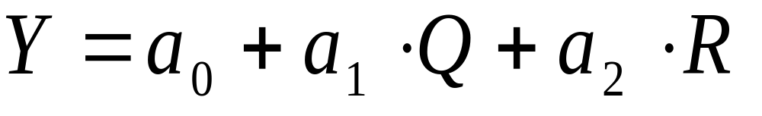
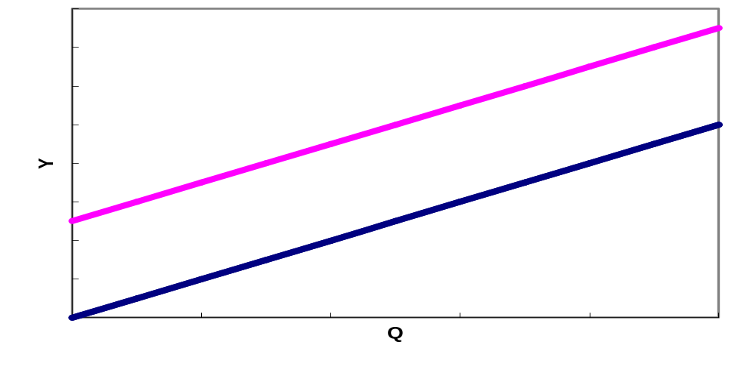
Multilinear Regression
Notes:
Quite powerful (surprisingly)
Often sufficient
But only captures linear behavior.

Slide 12
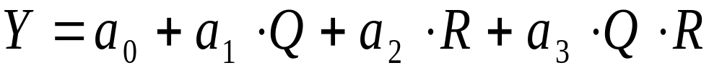
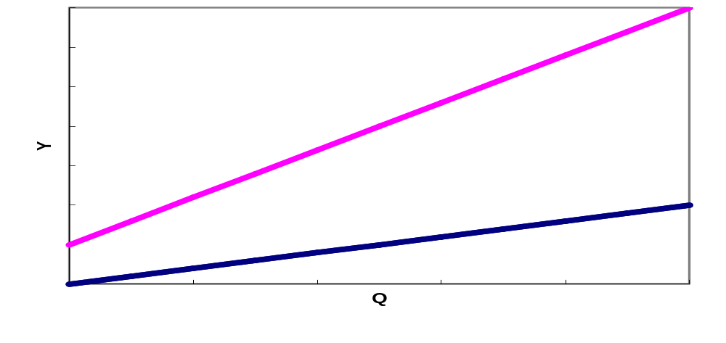
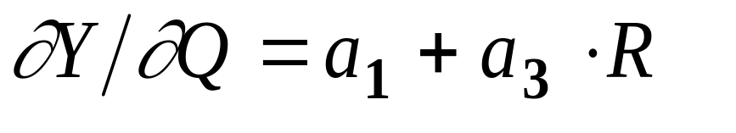
Interaction
Notes:
Clearly, interactions may occur
If they do, ignoring them results in mis-specified model; bias
Therefore, you should always check for nonlinearities.

Slide 13
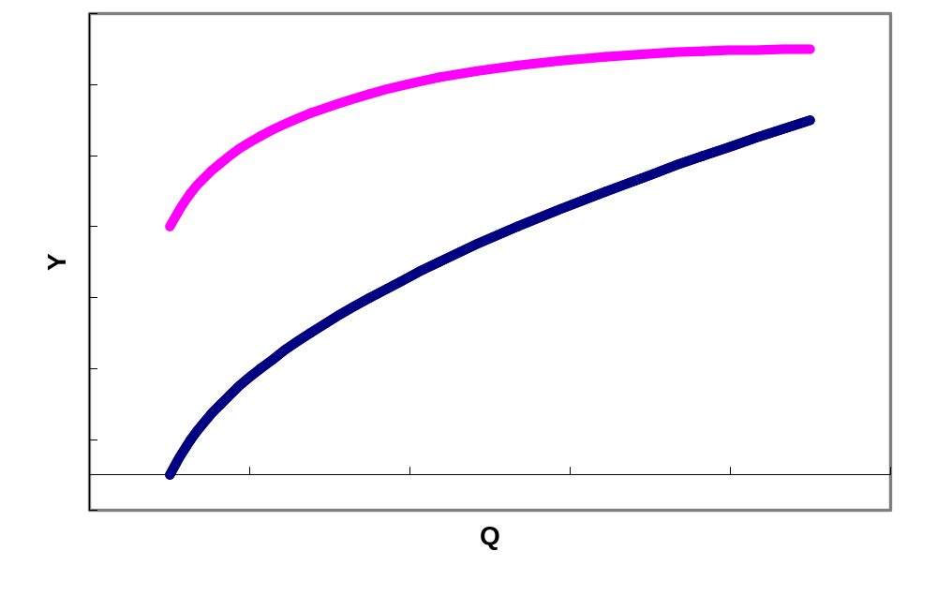
Curvilinear Interactions
Notes:
Same problem; ignoring causes mis-specification, bias
Curvature varies with parameter R
Y = 0.5 + Q + Q² +0.2*R² - 3.5*Q²*R

Slide 14
Example Polynomial Model
a₀ + a₁Q + a₂R + a₃S
+ a₄QR + a₅QS + a₆RS + a₇QRS
+ a₈Q² + a₉R² + a₁₀S²
+a₁₁Q²R + a₁₂Q²S + a₁₃Q²R² + a₁₄Q²S²
+ a₁₅R²S + a₁₆R²S² + a₁₇QR² + a₁₈QS² + a₁₉RS²
+a₂₀Q²RS + a₂₁Q²R²S + a₂₂Q²RS² + a₂₃QR²S² + a₂₄QR²S + a₂₅QRS²+ a₂₆Q²R²S²
Notes:
By limiting exponents to {0, 1, 2}, there will be 27 terms -- if all are included in model.
In practice, only those which are significant should be included.
Multilinear regression software provides a test -- the t-statistic, which indicates which are significant.
Terms should be added or removed one-at-a-time.
Number of candidate terms could be large unless you restrict:
the number of possible exponents
(which may include negative numbers, therefore making possible terms consisting of ratios of ind. variables)
the maximum number of multiplicands
(3 in example, but 2 usually works well)

Slide 15
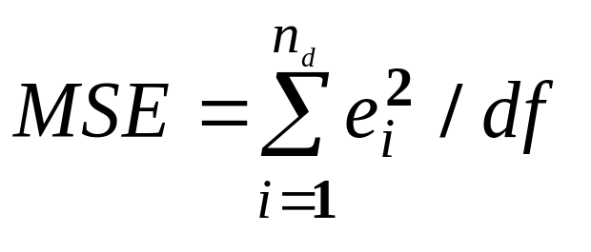
Fitting Procedure
Stepwise regression
  Select exponent list
  Generate candidate terms
  Add candidates to model one-at-a-time
  Select only statistically significant terms
  Stop when no remaining candidates can improve criterion.
Criteria
Notes:
Stepwise Regression
Converges to “locally optimum” model
Avoids insignificant coefficients
Criteria
t-statistic
SSE
MSE
F - statistic
AIC - Akaike Information Criterion
BIC - Bayesian Information Criterion

Slide 16
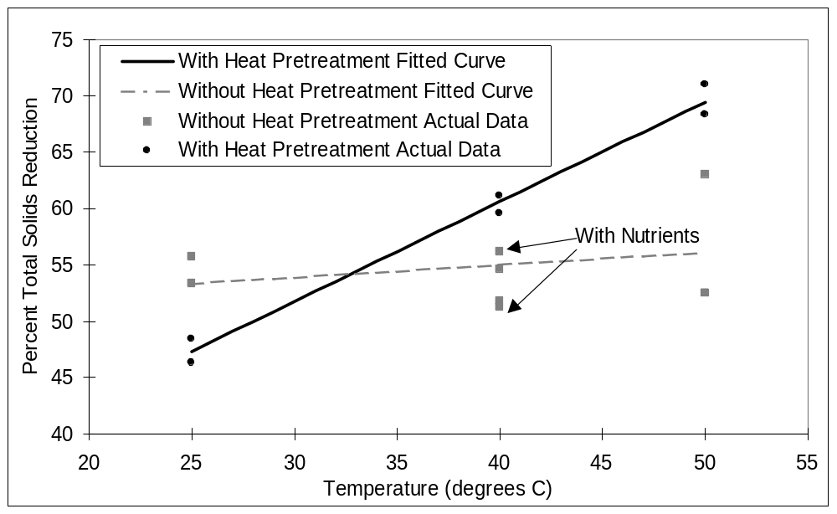
Interaction Between Temperature and Pretreatment
at 16 days
Notes:
This is an example of a model fitted to data on percent biodegradation of biomass versus temperature (T), with pretreatment by heating as a parameter (H). It shows an example of interaction.

Slide 17
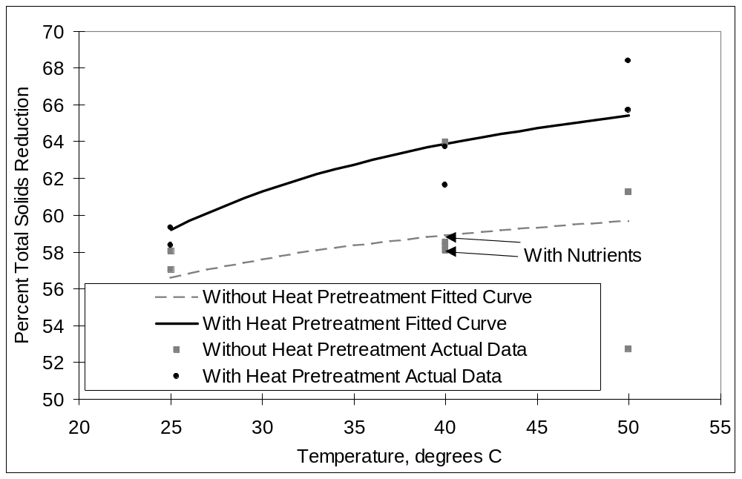
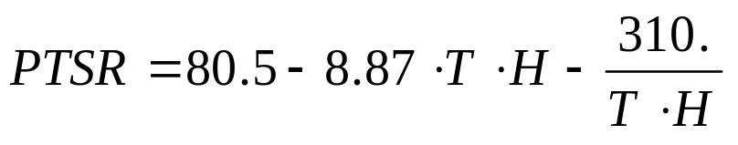
Curvilinear Interactions Between Temperature and Pretreatment at 32 days
Notes:
This is a similar dataset as the previous slide, but measured after a different time period. In this case the data show significant curvilinear interaction.

Slide 18
Multivariable Polynomial Regression (MPR)
Taylor-series-like
Converges absolutely
Amenable to further analysis:
  Sensitivity
  Confidence intervals
  Graphical
Resistant to overfitting (especially if cross-validated)
Parsimonious
Less restrictive a priori structure assumptions
Notes:
Quite general
Taylor-series-like (truncated)
Converges absolutely -- finite number of candidate terms
Amenable to further analysis:
Sensitivity
Confidence intervals
Graphical
Resistant to overfitting (especially if cross-validated)
Parsimonious
Less restrictive a priori structure assumptions

Slide 19
Logical Properties of Polynomials
A .and. B = AB
A .or. B = A + B - AB
A .xor. B = A + B - 2AB
.not. A = 1 - A
(A.and.B) .or. C = AB + C - ABC
Notes:
Remember the perceptron criticism. The early artificial neural networks could not perform the “exclusive or” operation.
This shows that polynomials have the capability to describe logical relationships.
To see this, use TRUE=1 and FALSE=0 and plug into the polynomials. Compare predictions with truth table for each logical relation.
This shows capability of polynomials to describe complex relationships.
Multi-level logic can also be easily handled: e.g 3-level (-1, 0 1)

Slide 20
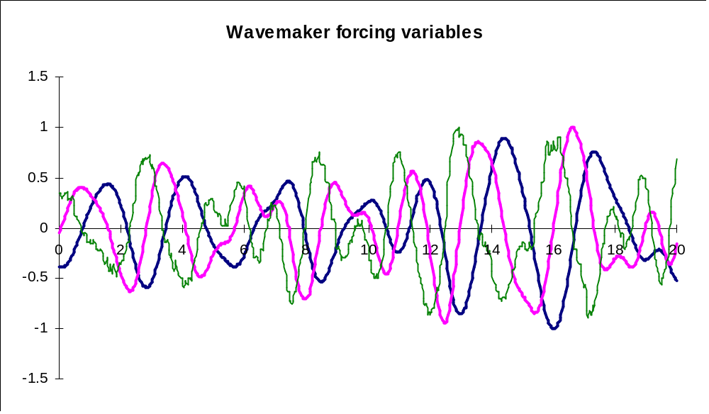
Predicting Wave-Tank Failure
Notes:
This shows the forcing variables for a wavemaking machine in a nautical model ship-testing facility. The facility had a problem that it would “trip” under certain, unknown, combinations of the forcing variables.
A set of experiments were fitted using MPR in which the dependent variable was set to 0 to denote “did not trip”, and to 1 for “tripped out”.

Slide 21
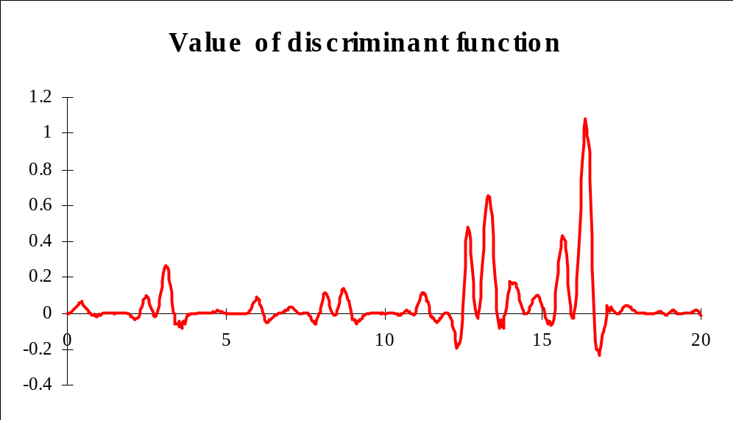
Discriminant function predicts system shutdown
Notes:
When the forcing variables from the previous slide were input to the model, the prediction stayed below 1.0 until 16 seconds.
When the same forcing variables were applied to the real wave machine, it indeed tripped out at 16 seconds.

Slide 22
Retail Performance Data
Variable Name sR²
Supplies/equipment ratio SE 0.646
Market share M 0.233
Years at location Y 0.148
Sales S 0.090
Walk-in/deliver ratio W 0.034
Store Quality Q 0.030
Intensity of competition C 0.015
Notes:
This is an example in the prediction of gross margin at 60 Retail Stores catering to industrial sales.
Variables: (*coded variables)
GM Gross Mean (dependent variable)
SE Supplies/Equipment Ratio
M Market Share
Y Years at Location
S Sales volume
W Ratio of walk-in/delivery sales
Q Store quality*
C Intensity of competition *
Industrial concentration
Rural vs. Urban location
Highway visibility
Number of staff at store
Avg. years of experience of staff
Number of salespersons

Slide 23
Multilinear Model
GM = 0.46 x SE + 0.13 x M
R² = 0.63 (63%)
Notes:
This is the best linear model for predicting gross margin.

Slide 24
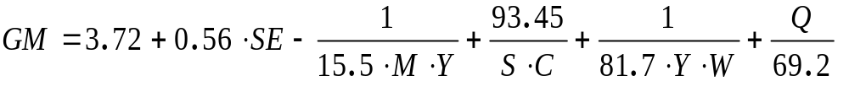
MPR Model
R² = 0.82 (82%)
Notes:
This is the MPR model that was developed. Note sensitivity of SE is increased! Linear model underestimated its effect, even though it is still linear!
Notice nonlinear interaction between market share and age of store.
MaxNumMultipliers NumIndVar NumTerms
2 7 6
N/D ivColNo lag exp . . . Coeff tStat
1 6 0 1.0 0 0 0.0 5.2726e-01 12.33
1 0 0 0.0 0 0 0.0 1.6079e-01 6.17
1 2 0 1.0 0 0 0.0 4.5019e-02 1.94
1 2 0 -1.0 3 0 -1.0 -5.2444e-02 -5.34
1 1 0 -1.0 4 0 2.0 6.5687e-02 4.44
1 3 0 -1.0 7 0 -1.0 9.5725e-03 2.29
DF, NP, ND, TSS, SSE:
48 6 54 0.188 3.452e-02
RSQ, CRSQ, MSE, FSTAT :
8.160e-01 1.840e-01 7.192e-04 3.55e+01
logCRSQ, logMSE, AIC, BIC :
-7.353e-01 -3.143e+00 -2.921e+00 -2.951e+00

Slide 25
Variables not used in model
Industrial concentration
Rural/Urban location
Highway visibility
# of staff
Average years of service
# of salesmen
Notes:
MPR can tell you directly if a variable contributes to predictability. It is sometimes important to know which variables do not correlate, as well as knowing which ones do.
Multicollinearity results in only one of highly correlated variables being included in the model.

Slide 26
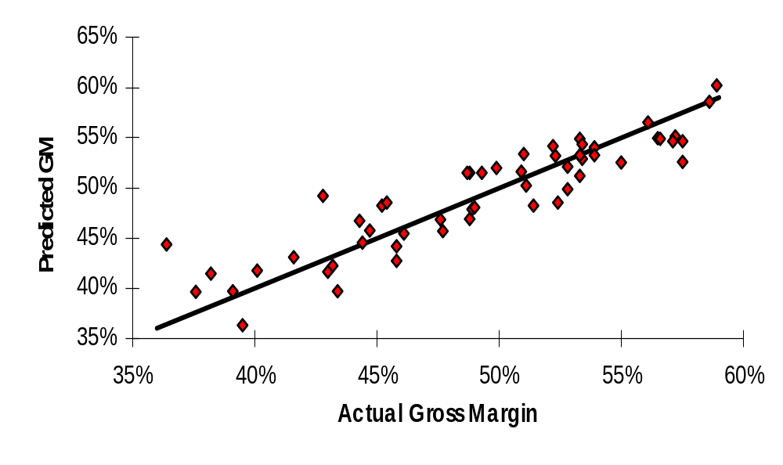
Comparison of Predictions and Observations
Notes:
Outliers can be examined:
High values are “stars”
Low values should be examined to identify other causes.
Watch out for influential points

Slide 27
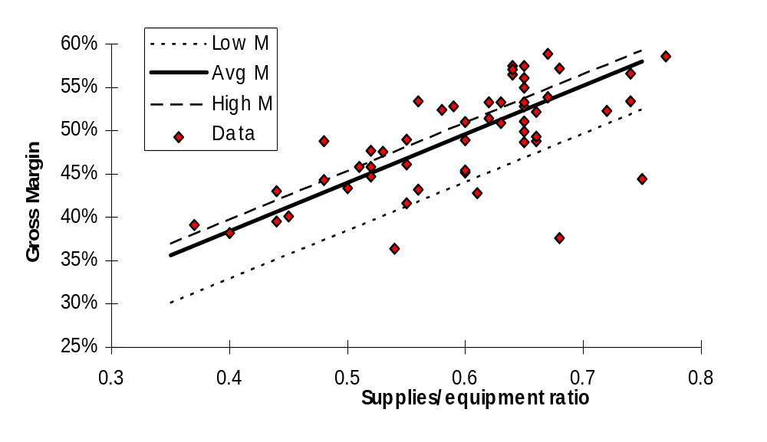
Effect of
Supplies/Equipment ratio with Market Share as a parameter
Notes:
Shows nonlinear effect of Market Share. Note that stores with age less than the average have lower gross margin, but older stores do not improve beyond the average.
Linear models cannot describe this kind of behavior.

Slide 28
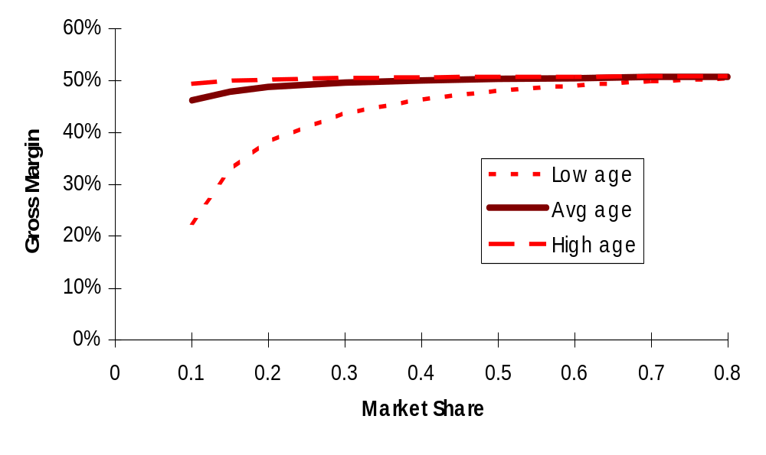
Effect of Market Share with Years at Location as a parameter
Notes:
This shows another view of the nonlinear behavior in the model.
It shows that only NEW stores are sensitive to Market Share. Once a store reaches average age, Market Share does not have a significant effect on gross margin.

Slide 29
PARX Models
(Polynomial AutoRegressive with eXogenous variables)
Included lagged variables as independent variables
Notes:
The PARX model is an MPR time-series model. It can model autocorrelations, similar to autoregressive (Box-Jenkins) models, or vector autocorrelations.

Slide 30
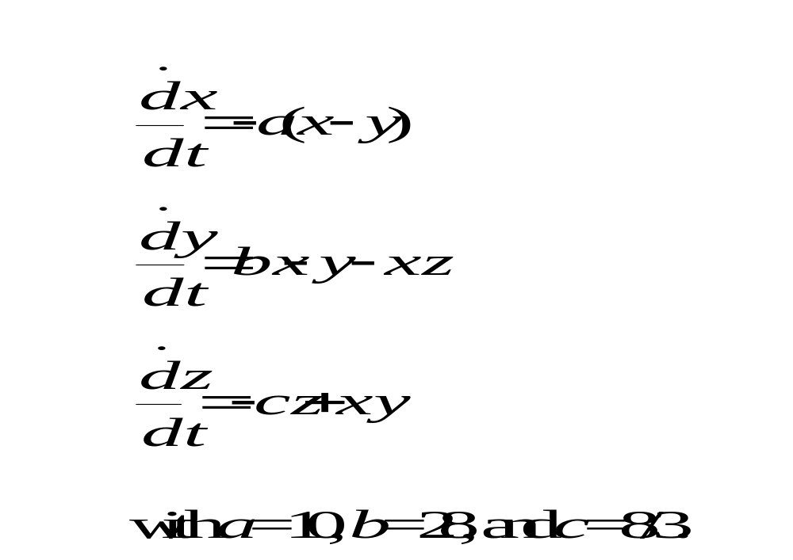
Lorenz System
Notes:
As an example of a vector autocorrelation, we use the Lorenz system, which is a simplified model of thermal convection in a fluid. This is a chaotic nonlinear system of ordinary differential equations. Being chaotic, it represents a particular challenge for modeling capability.

Slide 31
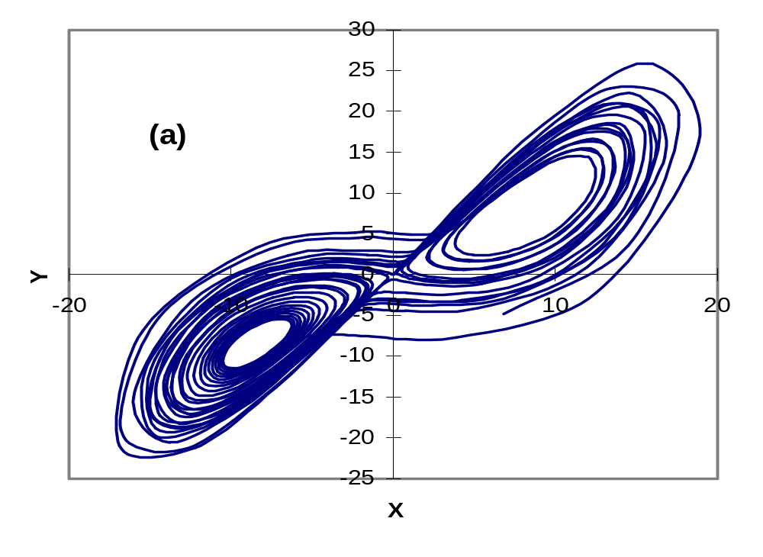
Lorenz Attractor
Notes:
This shows a phase-plane trajectory plot of the chaotic Lorenz attractor.

Slide 32
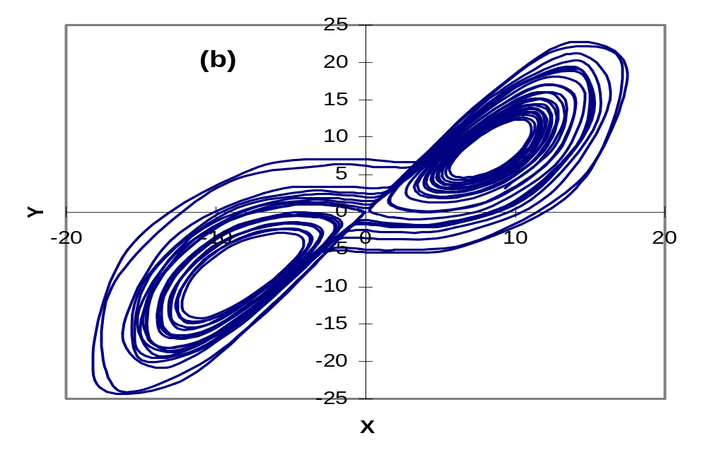
Polynomial model of attractor
Notes:
This is the predicted trajectory of the PARX model fitted to data from numerical simulation of the Lorenz equations.
It can be seen that the behavior of the original equations is well captured, without knowledge of the underlying ODEs.
Furthermore, a key dynamic parameter set, the Lyapunov coefficients, can be computed from the PARX model. The values accurately reflected those computed using the original ODE system.

Slide 33
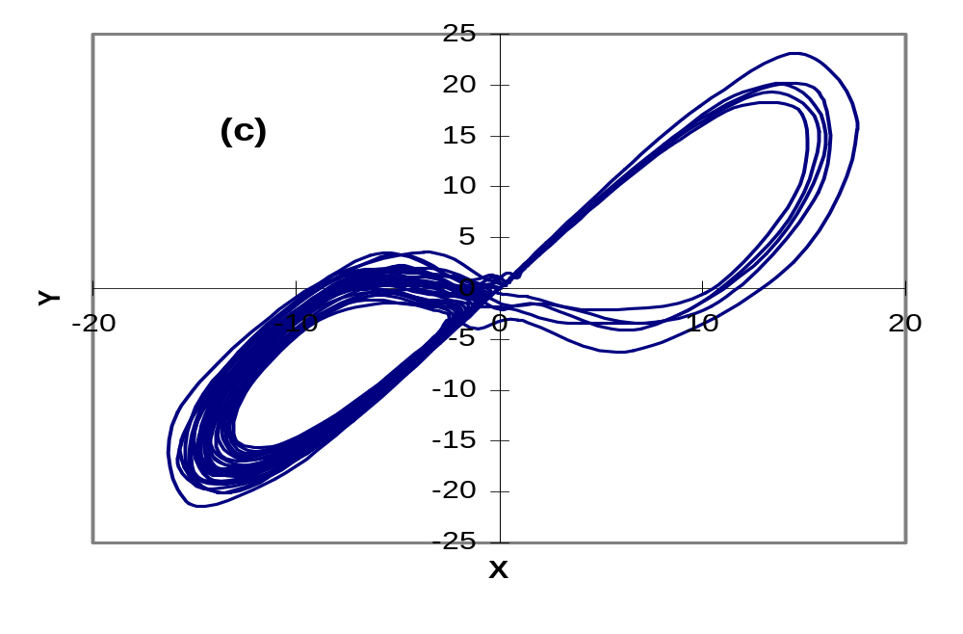
Modeled attractor with noise
Notes:
This shows the predicitons of a PARX model fitted to Lorenz simulation data that has 10% noise added (on an RMS basis).
This shows that PARX can filter noise from the data to reveal underlying behavior
The Lyapunov coefficient was again accurately measured.
This again demonstrates the power of MPR to discover underlying behavior in data.

Slide 34
Some Useful Properties of MPR Models
Optima can be internal;
Availability of standard statistical techniques.
Notes:
Linear models have optima always at boundaries. By using nonlinear models, we allow the realistic situation in which the optimum may be found within the constraints of a system.
The use of MPR enables the use of standard statistical model-testing techniques, such as hypothesis testing to compare different models.

Slide 35
EMPIRICAL MODELING WITH MULTIVARIABLE POLYNOMIALS
AND WHY NEURAL NETWORKS SHOULD MAKE YOU NERVOUS
David A. Vaccari
email: dvaccari@stevens-tech.edu
webpage: http://attila.stevens-tech.edu/~dvaccari/

